Slide 1
UNIT – I
Introduction to Web Technologies

Slide 2
Syllabus
INTRODUCTION TO WEB TECHNOLOGIES
HTML: Getting started with HTML, Why HTML, Tags and Elements, Attributes, Properties, Headings list, Links, Tables, Images, HTML Form, Media (Audio, Video), Semantic HTML5 Elements.
CSS: Why CSS, Types of CSS, How to use CSS, Properties, Classes, Child-Class (Nested CSS), Colors, Text, Background, Border, Margin, Padding, Positioning (flex, grid, inline, block), Animation, Transition.
BOOTSTRAP: Why Bootstrap, CSS over Bootstrap, How to Use Bootstrap, Bootstrap Grid System, Bootstrap Responsive, Bootstrap Classes, Bootstrap Components (i.e., Button, Table, List, etc.), Bootstrap as a Cross Platform. https://www.youtube.com/watch?v=R6AEjUewTNw
W3C: What is W3C , How W3C handles/Supports Web Technologies.

Slide 3
Introduction to Web Technology
Web
The web is collection of documents that are interconnected by hyper links.
These documents are accessed by web browsers and provided by web servers.
WWW (World Wide Web)
The WWW sometimes only pronounced simply as Web, is a way of retrieving information over the internet.
HTTP protocol is used by the web to transmit data over the internet.

Slide 4
Cont..
Website
A website is made up of web pages. These web pages also known as web documents are interconnected with each other with the help of hyperlinks.
Such webpages can be accessed by using various web browsers like IE, Chrome, Firefox etc.. The web document can contain tables, simple text, graphics etc..
Web sites are usually created for commercial purpose. There are various extensions of web sites depending upon their prime purpose.
.com – Commercial
.org – Organization
.net – Network
.biz – Business
.edu – Education

Slide 5
Cont..
Website :
Also there are some extensions depending upon the countries
.in - India
.uk – United Kingdom
.us – America
.nz – New Zealand

Slide 6
Cont..
For any Website there are basically 2 important aspect
Web Designing
Web Development (Scripting)
Web Designing
As the basic intention of web site is always commercial, it s necessary
that the website should be user friendly and attractive.
For designing purpose various scripting languages like HTML, CSS and
software tools like Photoshop, CorelDraw, flash are used.

Slide 7
HTML

Slide 8
HTML
Getting started with HTML
Why HTML
Tags and Elements
Attributes, Properties, Headings list, Links, Tables, Images
HTML Form
Media (Audio, Video)
Semantic HTML5 Elements.

Slide 9


Slide 10
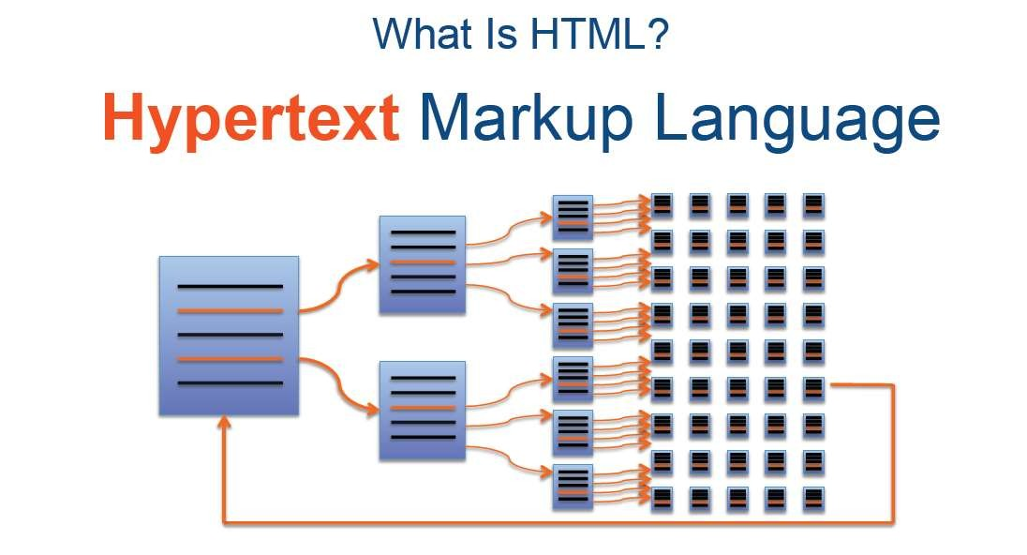
Web pages also known as web documents are interconnected
with each other with the help of hyperlinks.

Slide 11
HTML (Hyper Text Markup Language)
Structure of HTML document.
HTML document contain two main parts
Head :
The element contains title and matadata of a web document.
Used to declare variables and functions in scripting languages. These variables and functions are
then accessible throughout the page.
Body
Element contain the information which we like to display on a web page. All text to be displayed
and control creation is done in this section.

Slide 12
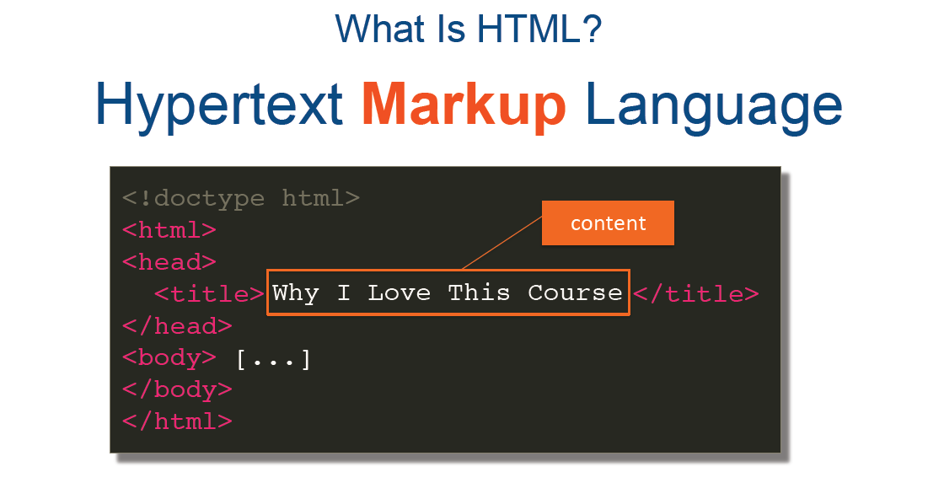

Slide 13
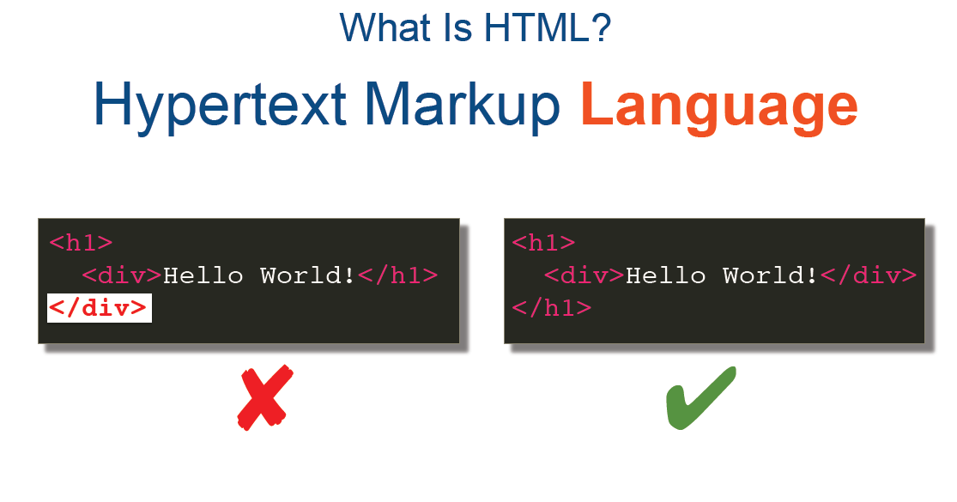

Slide 14
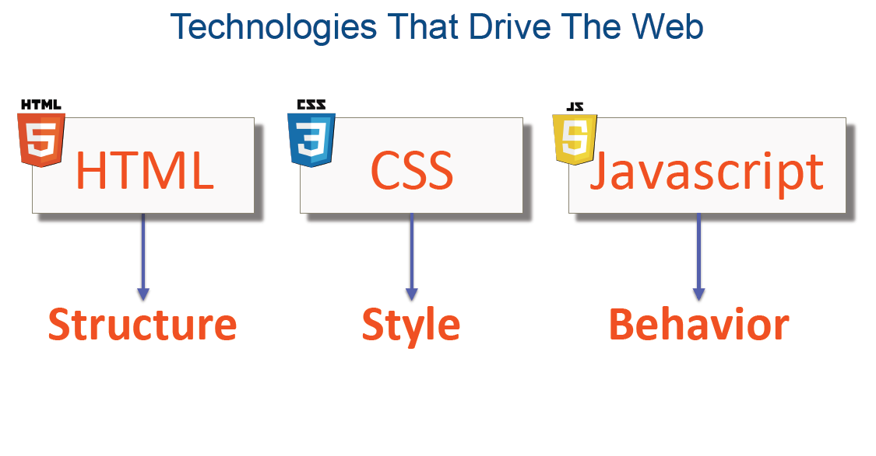

Slide 15


Slide 16
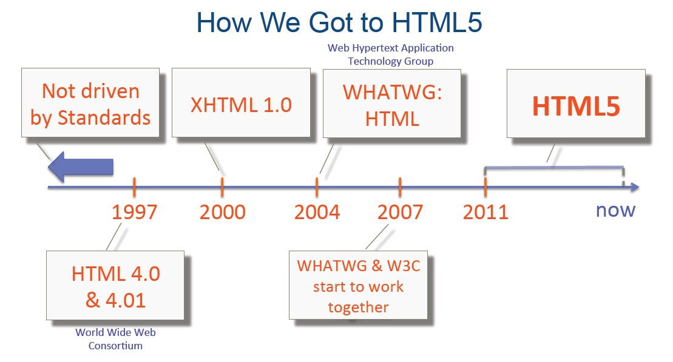

Slide 17
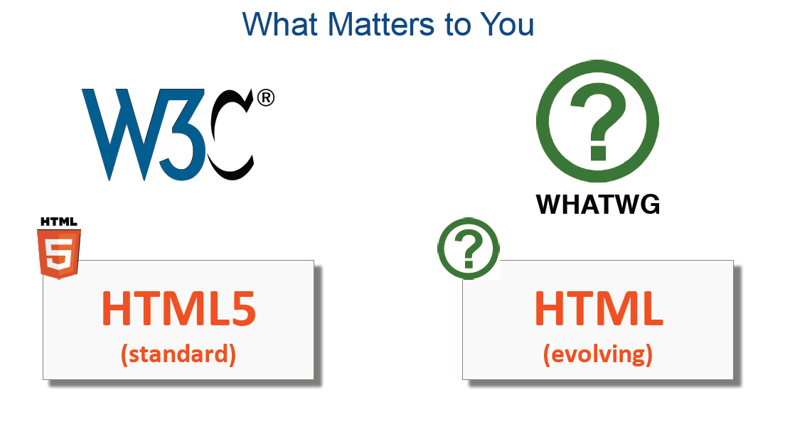

Slide 18


Slide 19
HTML Tags
HTML is a markup language and makes use of various tags to format the content.
These tags are enclosed within angle braces <Tag Name>. Except few tags, most of the tags have their corresponding closing tags.
For example, <html> has its closing tag </html> and <body> tag has
its closing tag </body> tag etc.

Slide 20
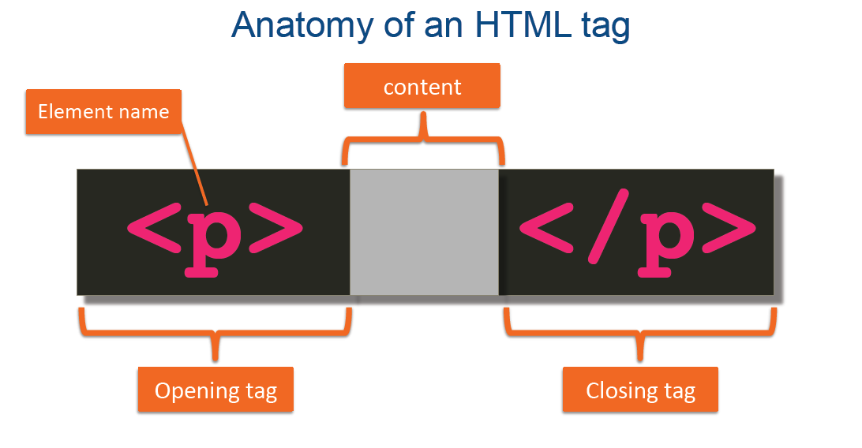

Slide 21
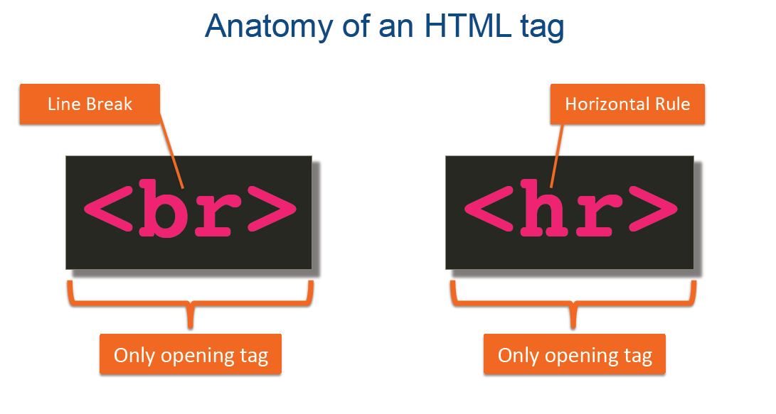

Slide 22
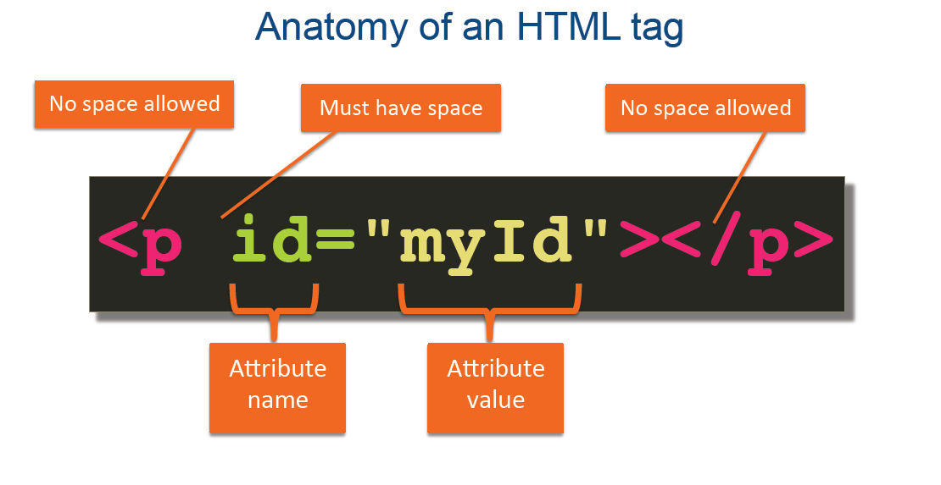

Slide 23
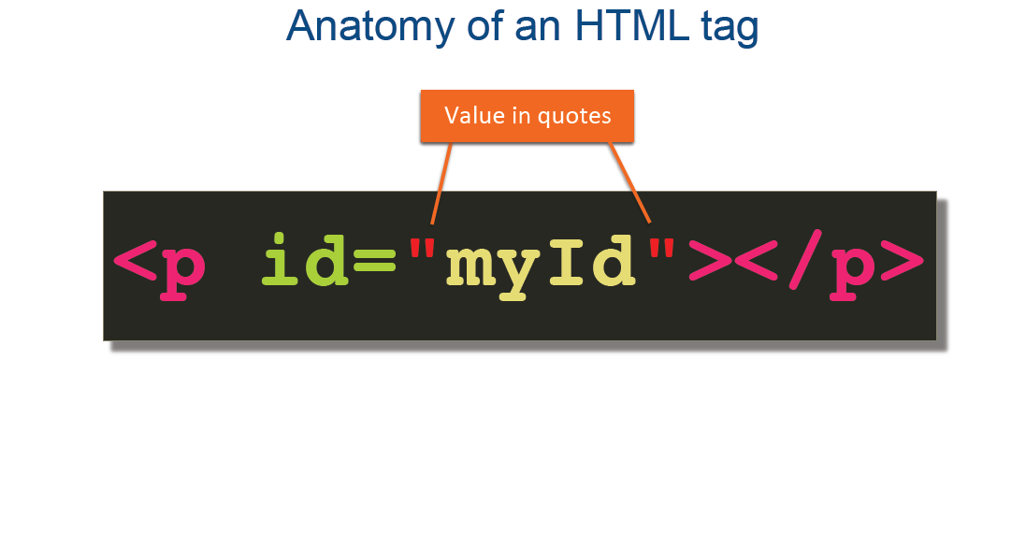

Slide 24
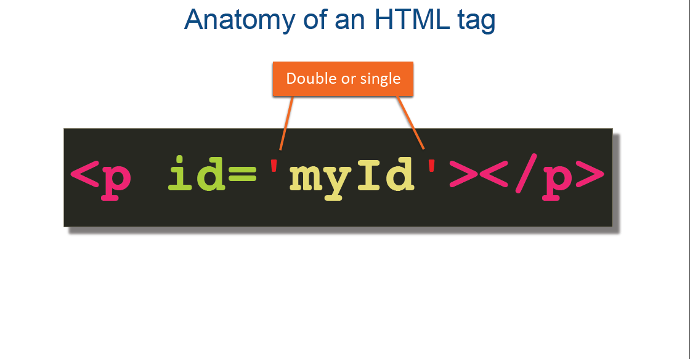

Slide 25
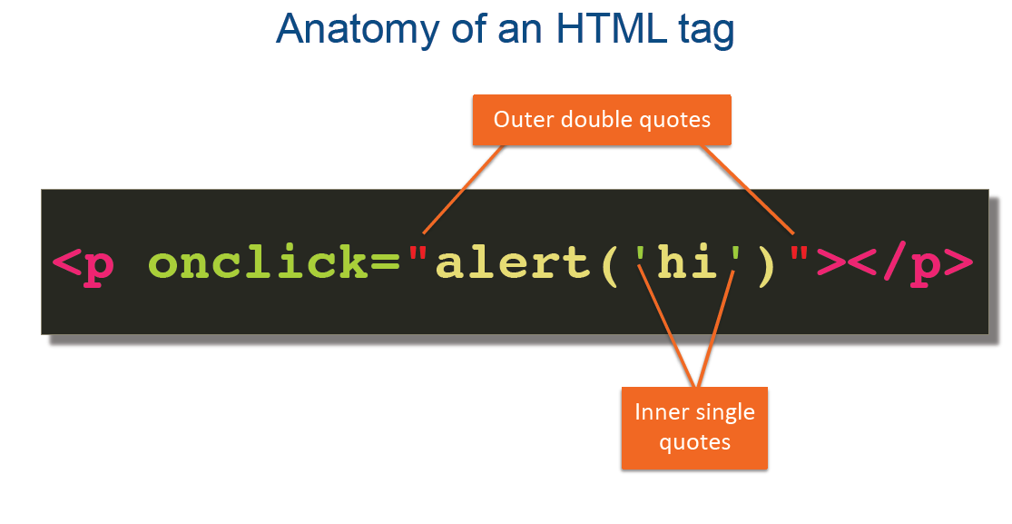

Slide 26
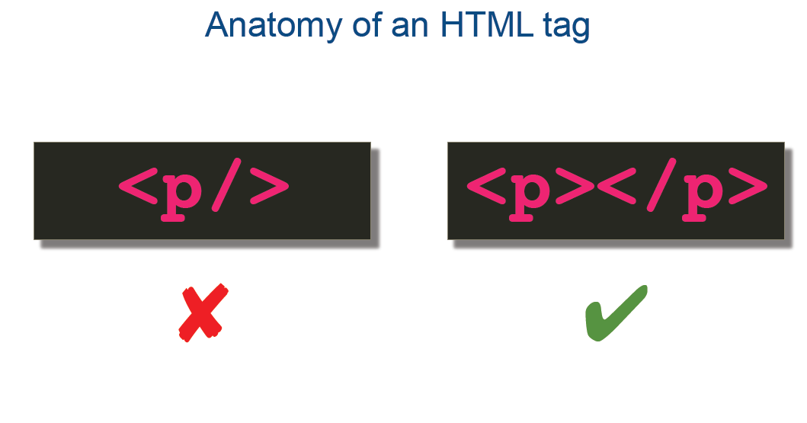

Slide 27
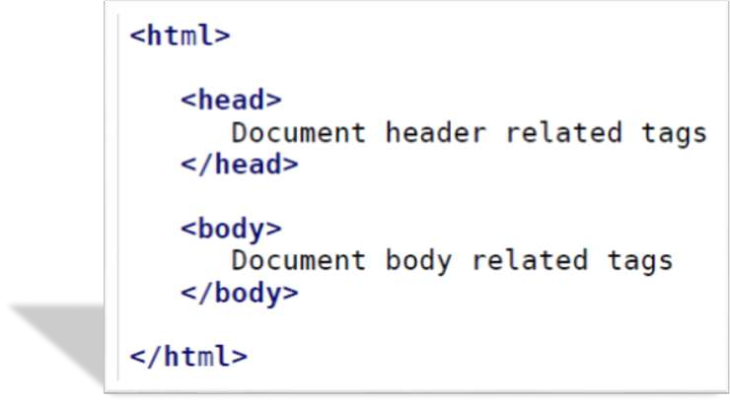
HTML Document Structure

Slide 28

HTML <!DOCTYPE> Declaration
<!DOCTYPE html>
<html>
<head>
<title>Title of the document</title>
</head>
1 to 7
<body>
The content of the document......
</body>
</html>
All HTML documents must start with a <!DOCTYPE> declaration.
In HTML 5, the declaration is simple:
<!DOCTYPE html>

Slide 29
The <!DOCTYPE> Declaration
The declaration is not an HTML tag.
The <!DOCTYPE> declaration tag is used by the web browser to understand the version of the HTML used in the document.
Current version of HTML is 5 and it makes use of the following declaration −
<!DOCTYPE html>

Slide 30
Browser Support
Older HTML Documents
In older documents (HTML 4 or XHTML), the declaration is more complicated because the declaration must refer to a DTD (Document Type Definition).
HTML 4.01:
<!DOCTYPE HTML PUBLIC "-//W3C//DTD HTML 4.01
Transitional//EN" "http://www.w3.org/TR/html4/loose.dtd">

Slide 31
<!DOCTYPE> declaration is NOT case sensitive.
Examples
<!DOCTYPE html>
<!DocType html>
<!Doctype html>
<!doctype html>
8
HTML <a> Tag
Example
Create a link to W3Schools.com:
<a href="https://www.w3schools.com">Visit W3Schools.com!</a>

Slide 32
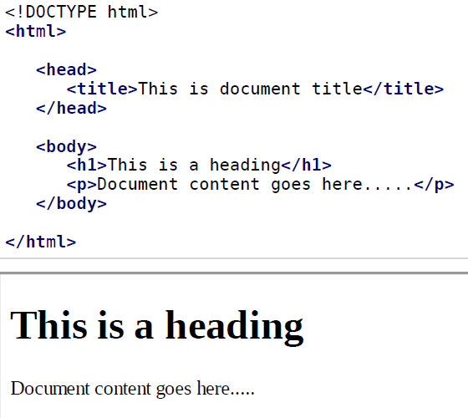
Basic HTML Document
Live Demo

Slide 33
HTML - Heading Tags
Any document starts with a heading. You can use different sizes for your headings. HTML also has six levels of headings, which use the elements <h1>, <h2>, <h3>, <h4>, <h5>, and <h6>. While displaying any heading, browser adds one line before and one line after that heading.
Live Demo

Slide 34
HTML Heading-Paragraph-Line Breaks
HTML tags are standard keywords in the web page which define how the web browser should format and display the content.
Headings
<h1>
<h2>
</h1>
</h2>
Upto <h6>
Paragraph <p>
</p>
Line Breaks <br> it works like /n in C programming.

Slide 35
HTML Color and Font Tags
Colors and Fonts
Colors
Attributes of <body> tag
bgcolor
Used to set background color of the page
text
Used to set color to the body text.
alink
Used to set color to the active links or selected links
link
Used to set color to the linked text
vlink
Used to set the color to the visited links i.e for linked text that you have already clicked on

Slide 36
HTML Frames
Frames :
Usually we can display only one web page at a time in the browser window.
if we wish to display multiple pages at a the same time on the browser window, then we can use the frames to divide the window in the different sections and in each section we can display a separate webpage.
a group of frames in the window is called frameset.
In the frameset application the basic tag of html like <body> is not used.
<frameset> tag is used.
2 main attributes of <frameset>tag are:
Rows : Define the horizontal frames.
Cols : Define the vertical frames.

Slide 37
HTML Frames
<frameset> tag :
<frame> is the sub-tag of frameset. The <frame> tag has attribute “src” which we have to
specify the URL of the web page which we want to display in particular frame.
Attributes of <frameset>
Cols : Specifies the number of columns contained in the frameset and also size of all the
columns. We can set cols = “200, 400, 100” or cols = “20%, 70%, 10%” or cols = “20%, *, 20%.
Rows : horizontal frames.
Rows = “20%, 80%” : It will generate two horizontal frames
Attributes of <frameset>
border : width of the border. For eg : border=“3”.
Frameborder : this attributes mentions whether to display a three dimensional border between frames or not. It takes value 1 (true) or 0 (false). For eg: frameborder = “1” specifies frame with three dimensional border.

Slide 38
HTML Lists
Lists:
Type of HTML list
Ordered
Type : 1. Number I: Upper roman i: Lower roman
A: upper Alpha
a: lower alpha
Unordered
Attribute : type : circle, square, disc
Definition
<dl> : Defining beginning of list
<dt> : Specify the term
<dd> : Specify term definition
</dl> : End of list

Slide 39
HTML Tables
HTML tables allow web developers to arrange data into rows and columns.
Each table cell is defined by a <td> and a </td> tag.
<table>
<tr>
<td>Emil</td>
<td>Tobias</td>
<td>Linus</td>
</tr>
</table>
Note: table data elements are the data containers of the table.
They can contain all sorts of HTML elements; text, images, lists, other tables, etc.

Slide 40
Table Rows
Each table row starts with a <tr> and end with a </tr> tag.
tr stands for table row.
Table Headers
use the <th> tag instead of the <td> tag
TAG | Description
<table> | It defines table
<tr> Table row | It defines a row in table
<th> Table heading | It define column headings
<td> Table data | It defines cell in table
<caption> | It defines caption of table

Slide 41
Attribute of Table tag
TAG | Value | Description
align | Left , center , right | Specifies the alignment of a table.
bgcolor | rgb(x,x,x) , #xxxxxx, colopname | Specifies the color for background
border | Any number | Specifies the size of border
cellpadding | Pixels | Specifies the space between cell wall and the cell content
Cellspacing | Pixels | Specifies the space between cells
Width | Pixels % | Specifies the width of table
Height | Pixels % | Specifies the height of table
Bordercolor | rgb(x,x,x) , #xxxxxx, colopname | Color of table border

Slide 42
Attribute of Table tag
Colspan and Rowspan Attribute:
Colspan :
Used to define the number of columns a cell should span (or merge) horizontally. Colspan
merge the cells horizontally, default value for colspan is 1.
<td colspan= 2> merged </td>
Rowspan:
Used to define the number of rows a cell should span (or merge) vertically. rowspan merge
the cells vwrtically, default value for rowspan is 1.
<td rowspan= 2> merged </td>

Slide 43
HTML Image
Images :
2 option to insert image in webpage
Using <body> tag : body tag has a background attribute to set image as a background of
the page.
<body background = “Desert.jpg”>
Using <img> tag
The background image occupies the entire background of webpage. We cannot set size or
location for it. <img> tag is used to insert images at desired location with desired size.
No need of closing tag

Slide 44
Attributes of Image Tag
Attribute | Value | Description
align | Top bottom left middle right | Specifies the alignment of an image
alt | Text | Defines an alternate text for the image
border | Pixels | Defines the width of the border around an image
height | Pixels | Defines the height of the image
hspace | Pixels | Defines the whitesapce on both of the left and right side of an image
vspace | Pixels | Defines the whitesapce on top and bottom of an image
src | URL | Defines the URL of an image
width | Pixels | Defines the width of the image

Slide 45
HTML form
The HTML form is a part of a document which may have general content, special elements known as controls like textfields, checkboxex , submit button, radio buttons etc. users usually complete the form by modifying it’s elements.
HTML forms are generally necessary when we want to accept some data from the website visitors. For example email account form, credit card form where we may like to accept information like name, email address, phone number, gender etc.

Slide 46
HTML
vs HTML5
HTML | HTML5
<audio> and <video> tags are not supported | <audio> and <video> tags are supported
Finding out geographical location is impossible using HTML | The HTML5 supports the API for identifying the geographic location
Supports tags such as <applet>, <center>, <font>, <frame>, <strike> | <applet>, <center>, <font>, <frame>, <strike> tags are removed from HTML5
Dose not allow Java script to run in browser. | It allows JavaScript to run in background.
There is no support for <canvas> | The <canvas> tag is for 2D drawing
It needs external plugins such as flash | The need for external plugin is reduced

Slide 47
Use CSS to style links
With CS..S, links can be styled in many different ways.
Links can be styled with any CSS property
e.g. color, font-family, background, etc.
Example
a {
color: hotpink;
}
9 & 10
four links states are:
a:link - a normal, unvisited link
a:visited - a link the user has visited
a:hover - a link when the user mouses over it
a:active - a link the moment it is clicked

Slide 48
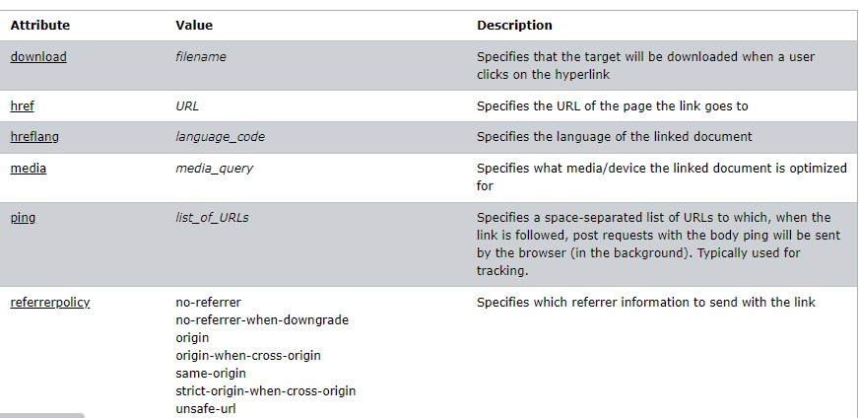
HTML Attributes

Slide 49
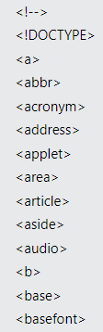
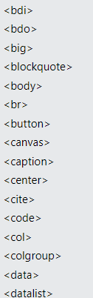
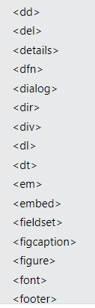
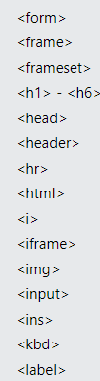
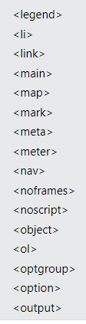
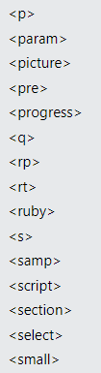
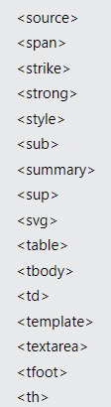
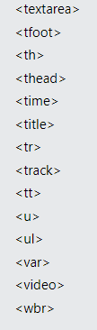
HTML Tags

Slide 50
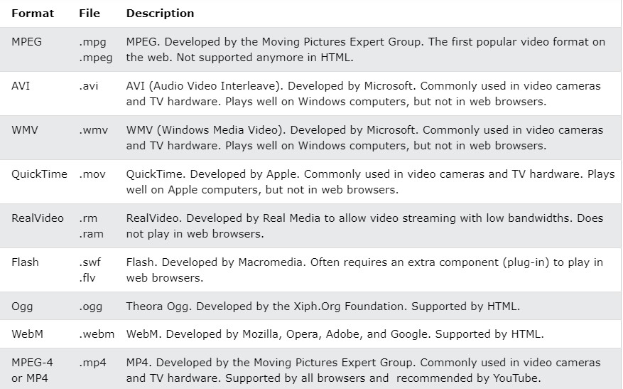
HTML Media

Slide 51
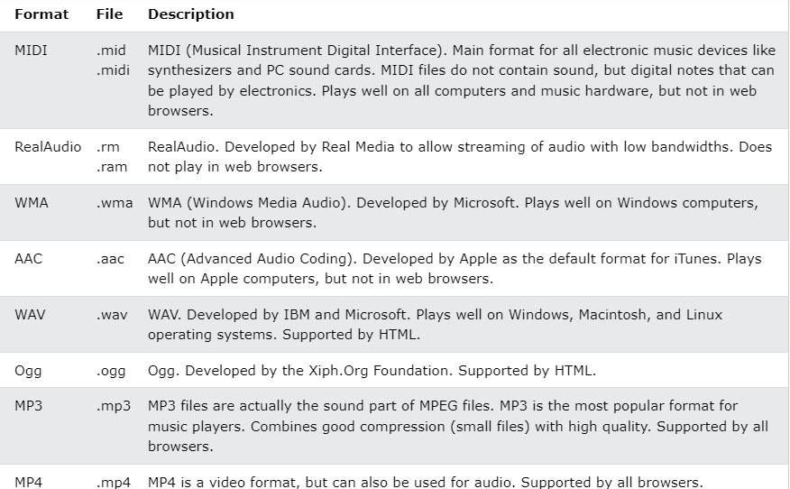
Common Audio Formats

Slide 52
HTML Video
To show a video in HTML, use the <video> element:
<video width="320" height="240" controls>
<source src="movie.mp4" type="video/mp4">
<source src="movie.ogg" type="video/ogg">
Your browser does not support the video tag.
</video>

Slide 53
Reference
https://www.w3schools.com/html/default.asp

Slide 54
CSS

Slide 55
CSS
Why CSS
Types of CSS
How to use CSS
Properties
Classes, Child-Class (Nested CSS)
Colors, Text, Background, Border, Margin, Padding
Positioning (flex, grid, inline, block), Animation, Transition

Slide 56
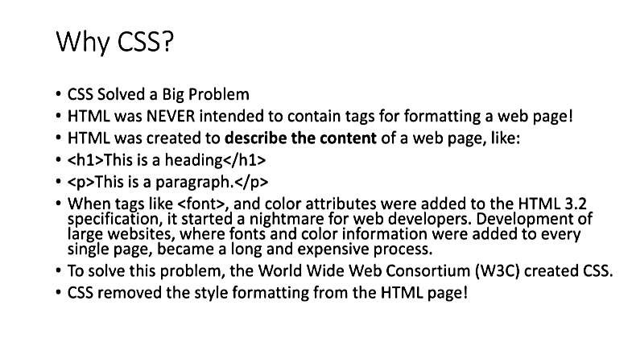

Slide 57
The good, the bad and the… ugly!
<p>
<font face="Arial">Shashdot.</font>
News for <b>nerds!!</b> You will <i>never</i>, <u>EVER</u>
be
<font size="+4" color="red">BORED</font> here!
</p> HTML
Slashdot. News for nerds!! You will never, EVER be BORED
here!
output
Tags such as b, i, u, and font are discouraged in strict XHTML
Why is this bad?
CS380
57

Slide 58
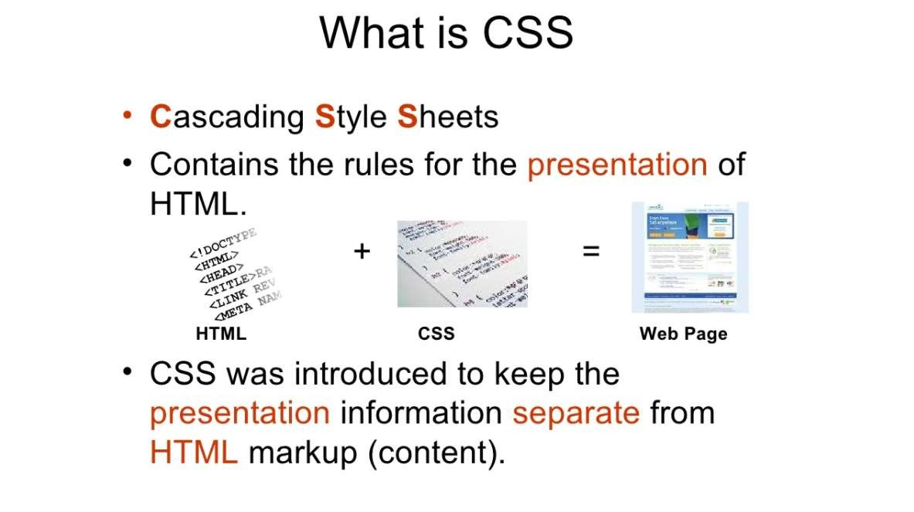

Slide 59
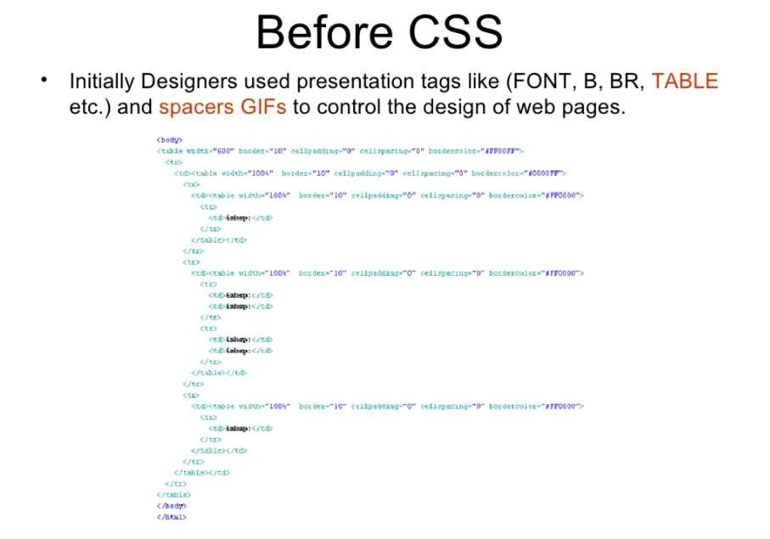

Slide 60
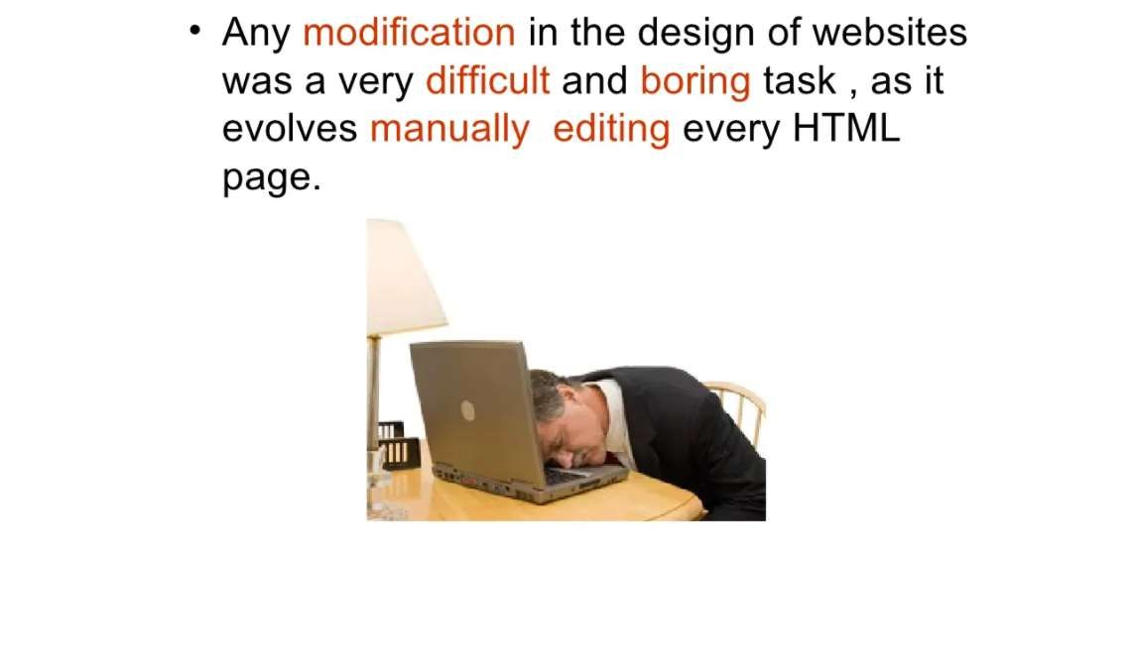

Slide 61
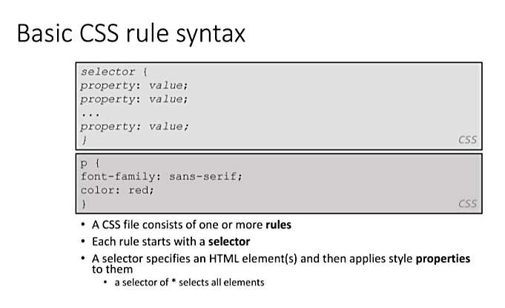

Slide 62
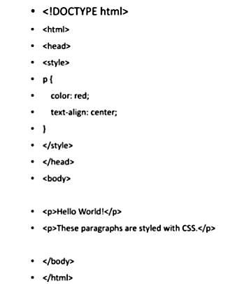

Slide 63
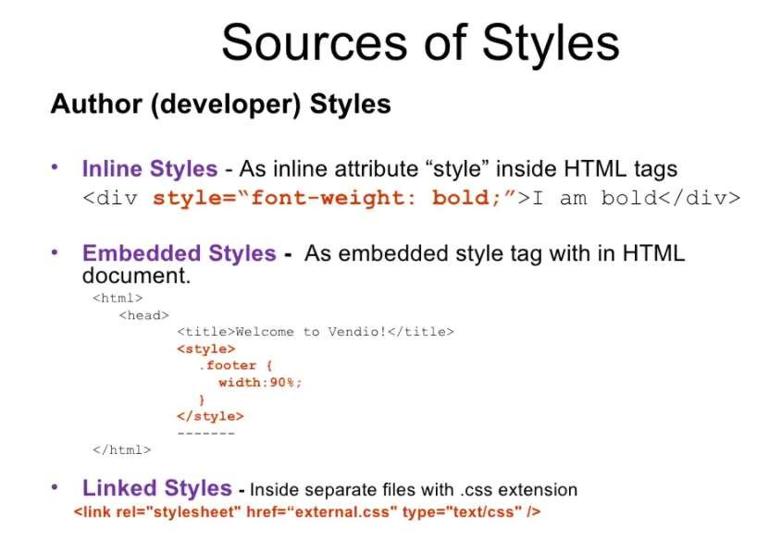

Slide 64
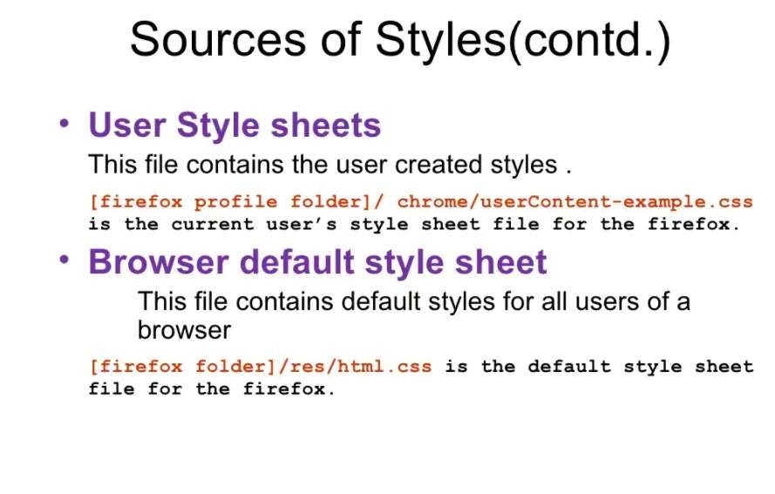

Slide 65
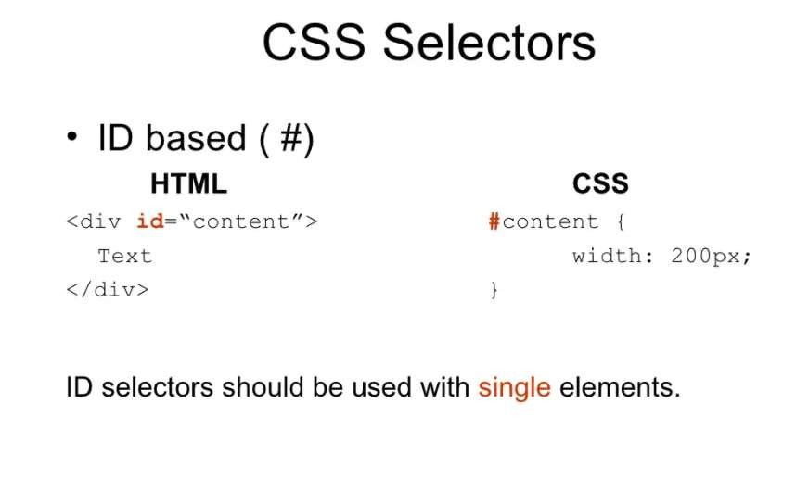

Slide 66
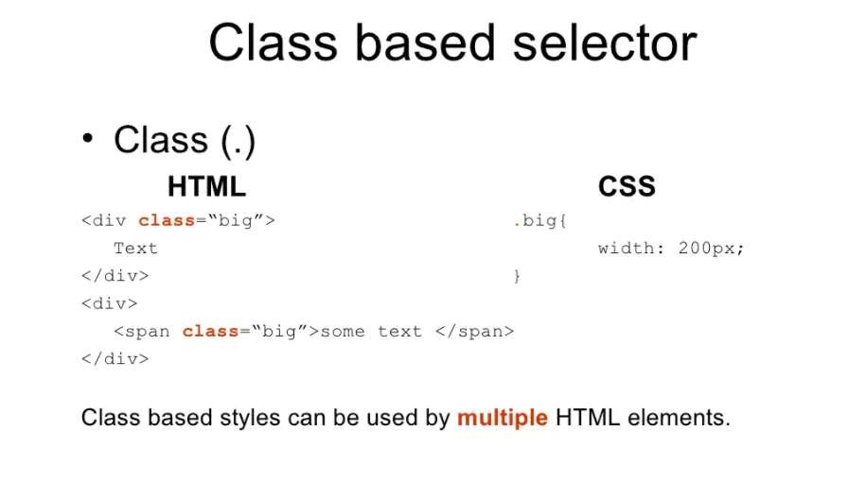

Slide 67
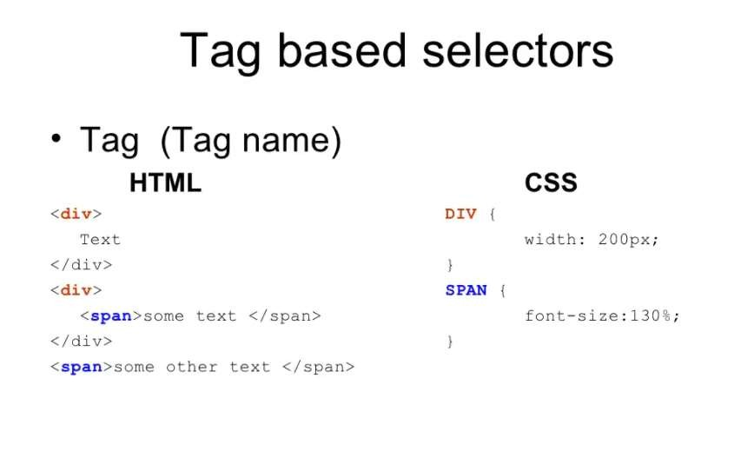

Slide 68
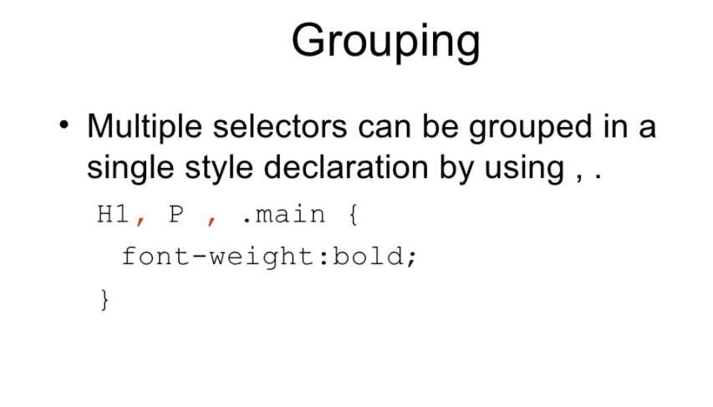

Slide 69
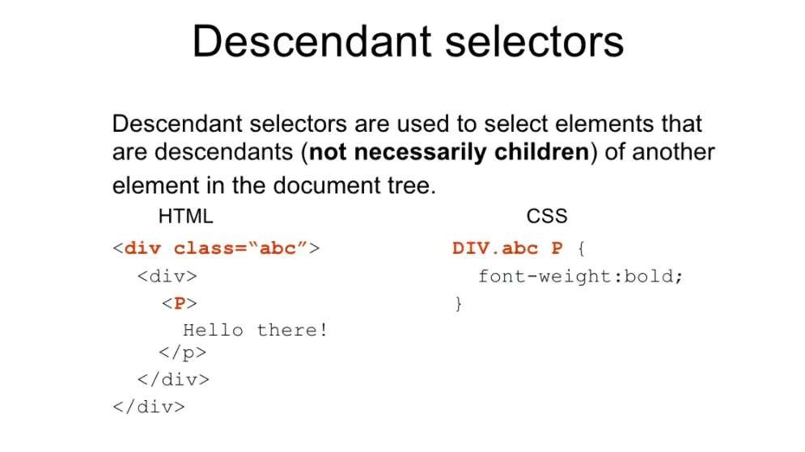

Slide 70
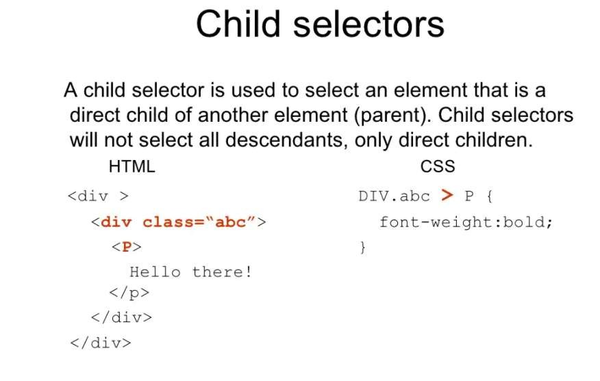

Slide 71
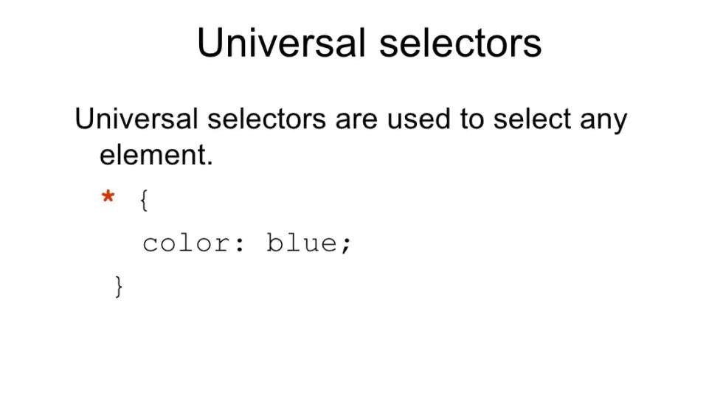

Slide 72
Basic CSS rule syntax
selector { property: value; property: value;
...
property: value;
}
CSS
p {
font-family: sans-serif;
color: red;
}
CSS
A CSS file consists of one or more rules
Each rule starts with a selector
A selector specifies an HTML element(s) and then applies style properties
to them
a selector of * selects all elements
72

Slide 73
Attaching a CSS file <link>
<head>
...
<link href="filename" type="text/css" rel="stylesheet" />
...
</head> HTML
<link href="style.css" type="text/css" rel="stylesheet" />
<link href="http://www.google.com/uds/css/gsearch.css"
rel="stylesheet" type="text/css" />
HTML
A page can link to multiple style sheet files
In case of a conflict (two sheets define a style for the same HTML element), the latter sheet's properties will be used
CS380
73

Slide 74
Embedding style sheets: <style>
<head>
<style type="text/css">
p { font-family: sans-serif; color: red; }
h2 { background-color: yellow; }
</style>
</head>
HTML
CSS code can be embedded within the head of an HTML page
Bad style and should be avoided when possible (why?)
CS380
74

Slide 75
Inline styles: the style attribute
<p style="font-family: sans-serif; color: red;">
This is a paragraph</p>
HTML
This is a paragraph
output
Higher precedence than embedded or linked styles
Used for one-time overrides and styling a particular element
Bad style and should be avoided when possible (why?)
CS380
75

Slide 76
CSS properties for colors
p {
color: red;
background-color: yellow;
}
CSS
This paragraph uses the style above output
property | description
color | color of the element's text
background-color | color that will appear behind the element
CS380
76

Slide 77
Specifying colors
p { color: red; }
h2 { color: rgb(128, 0, 196); }
h4 { color: #FF8800; }
CSS
This paragraph uses the first style above
This h2 uses the second style above.
This h4 uses the third style above.
output
color names: aqua, black, blue, fuchsia, gray, green, lime, maroon, navy,
olive, purple, red, silver, teal, white (white), yellow
RGB codes: red, green, and blue values from 0 (none) to 255 (full)
hex codes: RGB values in base-16 from 00 (0, none) to FF (255, full)
77

Slide 78
Grouping styles
p, h1, h2 {
color: green;
}
h2 {
background-color: yellow;
}
CSS
This paragraph uses the above style.
This h2 uses the above styles.
output
A style can select multiple elements separated by commas
The individual elements can also have their own styles
CS380

Slide 79
CSS comments /*…*/
/* This is a comment.
It can span many lines in the CSS file. */
p {
color: red; background-color: aqua;
} CSS
CSS (like HTML) is usually not commented as rigorously as
programming languages such as Java
The // single-line comment style is NOT supported in CSS
The <!-- ... --> HTML comment style is also NOT supported in CSS
CS380

Slide 80
CSS properties for fonts
property | description
font-family | which font will be used
font-size | how large the letters will be drawn
font-style | used to enable/disable italic style
font-weight | used to enable/disable bold style
Complete list of font properties (http://www.w3schools.com/css/css_reference.asp#font)
CS380

Slide 81
font-family
p {
font-family: Georgia;
}
h2 {
font-family: "Courier New";
}
CSS
This paragraph uses the first style above.
This h2 uses the second style above.
output
Enclose multi-word font names in quotes
CS380

Slide 82
More about font-family
p {
font-family: Garamond, "Times New Roman", serif;
} CSS
This paragraph uses the above style.
output
We can specify multiple fonts from highest to lowest priority
Generic font names:
serif, sans-serif, cursive, FANTASY, monospace
If the first font is not found on the user's computer, the next is tried
Placing a generic font name at the end of your font-family value, ensures that every computer will use a valid font
CS380

Slide 83
font-size
p {
font-size: 24pt;
} CSS
This paragraph uses the style above.
output
units: pixels (px) vs. point (pt) vs. m-size (em)
16px, 16pt, 1.16em
vague font sizes: xx-small, x-small, small, medium, large, x-large, xx-large, smaller, larger
percentage font sizes, e.g.: 90%, 120%
CS380

Slide 84
font-size
p {
font-size: 24pt;
} CSS
This paragraph uses the style above.
output
pt specifies number of point, where a point is 1/72 of an inch onscreen
px specifies a number of pixels on the screen
em specifies number of m-widths, where 1 em is equal to the font's current size
CS380

Slide 85
font-weight, font-style
p {
font-weight: bold;
font-style: italic;
}
CSS
This paragraph uses the style above.
output
Either of the above can be set to normal to turn them off (e.g.
headings)
CS380

Slide 86
CSS properties for text
property | description
text-align | alignment of text within its element
text-decoration | decorations such as underlining
line-height, word-spacing, letter-spacing | gaps between the various portions of the text
text-indent | indents the first letter of each paragraph
Complete list of text properties (http://www.w3schools.com/css/css_reference.asp#text)
CS380

Slide 87

text-align
blockquote { text-align: justify; }
h2 { text-align: center; }
CSS
The Gollum’s Quote
We wants it, we needs it. Must have the precious. They stole it from us.
Sneaky little hobbitses. Wicked, tricksy, false!
output
text-align can be left, right, center, or
justify
CS380

Slide 88
text-decoration
p {
text-decoration: underline;
}
CSS
This paragraph uses the style above.
output
can also be overline, line-through, blink, or none
effects can be combined:
text-decoration: overline underline;
CS380

Slide 89
The list-style-type property
ol { list-style-type: lower-roman; }
CSS
Possible values:
none : No marker
disc (default), circle, square
Decimal: 1, 2, 3, etc.
decimal-leading-zero: 01, 02, 03, etc.
lower-roman: i, ii, iii, iv, v, etc.
upper-roman: I, II, III, IV, V, etc.
lower-alpha: a, b, c, d, e, etc.
upper-alpha: A, B, C, D, E, etc.
x. lower-greek: alpha, beta, gamma, etc.
others: hebrew, armenian, georgian, cjk-ideographic, hiragana…
CS380

Slide 90
Body styles
body {
font-size: 16px;
}
CSS
Applies a style to the entire body of your page
Saves you from manually applying a style to each element
CS380

Slide 91
Cascading Style Sheets
Properties of an element cascade together in this order:
browser's default styles
external style sheet files (in a <link> tag)
internal style sheets (inside a <style> tag in the page's header)
inline style (the style attribute of the HTML element)
CS380

Slide 92
Inheriting styles
body { font-family: sans-serif; background-color: yellow;
}
p { color: red; background-color: aqua; } a { text-decoration: underline; }
h2 { font-weight: bold; text-align: center; }
CSS
This is a heading
A styled paragraph. Previous slides are available on the website.
A bulleted list output
when multiple styles apply to an element, they are inherited
a more tightly matching rule can override a more general inherited rule
CS380

Slide 93
Styles that conflict
p, h1, h2 { color: blue; font-style: italic; }
h2 { color: red; background-color: yellow; }
CSS
This paragraph uses the first style above.
This heading uses both styles above.
output
when two styles set conflicting values for the same property,
the latter style takes precedence
CS380

Slide 94
W3C CSS Validator
<p>
<a href="http://jigsaw.w3.org/css-
validator/check/referer">
<img src="http://jigsaw.w3.org/css-validator/images/vcss"
alt="Valid CSS!" /></a>
</p> CSS
output
jigsaw.w3.org/css-validator/
checks your CSS to make sure it meets the official CSS specifications
CS380

Slide 95
CSS properties for backgrounds
property | description
background-color | color to fill background
background-image | image to place in background
background-position | placement of bg image within element
background-repeat | whether/how bg image should be repeated
background-attachment | whether bg image scrolls with page
background | shorthand to set all background properties
CS380

Slide 96
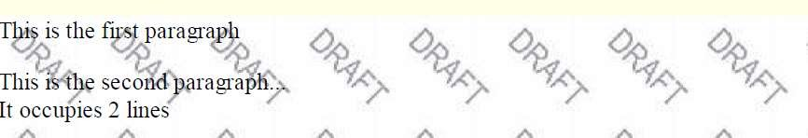
background-image
body {
background-image: url("images/draft.jpg");
}
CSS
background image/color fills the element's content area
CS380

Slide 97

background-repeat
body {
background-image: url("images/draft.jpg");
background-repeat: repeat-x;
}
CSS
can be repeat (default), repeat-x, repeat-y, or no-repeat
CS380

Slide 98
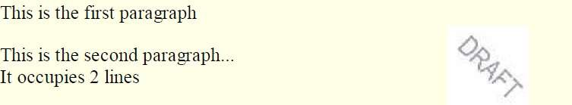
background-position
body {
background-image: url("images/draft.jpg");
background-repeat: no-repeat; background-position: 370px 20px;
}
CSS
value consists of two tokens, each of which can be top, left, right, bottom, center, a percentage, or a length value in px, pt, etc.
value can be negative to shift left/up by a given amount
CS380

Slide 99
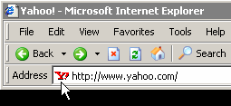
Aside: Favorites icon ("favicon")
<link href="filename" type="MIME type" rel="shortcut icon"
/> HTML
<link href="yahoo.gif" type="image/gif" rel="shortcut
icon" />
HTML
The link tag, placed in the HTML page's head section, can specify an icon
this icon will be placed in the browser title bar and bookmark/favorite
CS380

Slide 100
Cascading Style Sheet.
It is a markup language used in the web document for presentation purpose.
Primary intension of CSS was to separate out the web content from the web
presentation.
Advantages:
By combining CSS with the HTML document, flexibility can be achieved.
Help in managing large scale complex sites.
If CSS is used effectively then global style sheet can be applied to a web document. This
maintains the consistency.
If small changes need to be done in style of web content, then use of CSS is more
convenient.

Slide 101
There are three level of Cascading Style Sheet.
Inline Style sheet
Document level style sheet / Internal Style sheet
external level Style sheet

Slide 102
CSS selectors used to select the specific content which we want to style. Selectors are the internal part of CSS rule set.
CSS selectors chose the different HTML element as per Id, Class, type, attribute.
Type of Selectors:
CSS element selector
CSS Id selector
CSS class selector
CSS Group selector
CSS universal selector : will be apply to all elements

Slide 103
CSS Element Selector
Simple selector form is a single element to which the property and value is applied.
CSS Class Selector
Using class selector we can apply different styles to the same element
CSS Id Selector
The Id selector is similar to the class selector.
CSS Generic Selector
We define the class in generalized form.
Particular class can be apply to any tag.
CSS Universal Selector
This selector can be applied to all the elements in the document

Slide 104
BOOTSTRAP
Why Bootstrap
CSS over Bootstrap
How to Use Bootstrap
Bootstrap Grid System
Bootstrap Responsive
Bootstrap Classes
Bootstrap Components (i.e., Button, Table, List, etc.)
Bootstrap as a Cross Platform.

Slide 105
W3C
What is W3C
How W3C handles/Supports Web Technologies

Slide 106
Thank You!!

